Slide 1
Industrial training report
Submitted By
Name: VAIBHAV BHALLA
University Roll No. 03314802721

Slide 2
About the course:
The Complete 2023 Web Development Bootcamp, by instructor Angela Yu.
The course covers both front-end and back-end development.
The course encompasses HTML 5, CSS 3, Bootstrap 5, JavaScript ES6, jQuery, Node.js, Express.js, RESTful APIs, databases (SQL, MongoDB, Mongoose), React.js, authentication, and more. Students also explore Web3 Development, Blockchain technology, and NFT minting.

Slide 3
Technology stack:
Front-End Web Development
HTML 5
CSS 3
Flexbox
Grid
Bootstrap 5
JavaScript ES6
DOM Manipulation
jQuery
Back-End Web Development
Node.js
NPM packages
Express.js
EJS
RESTAPIs
Databases – SQL and NoSQL
MongoDB and Mongoose
Authentication

Slide 4
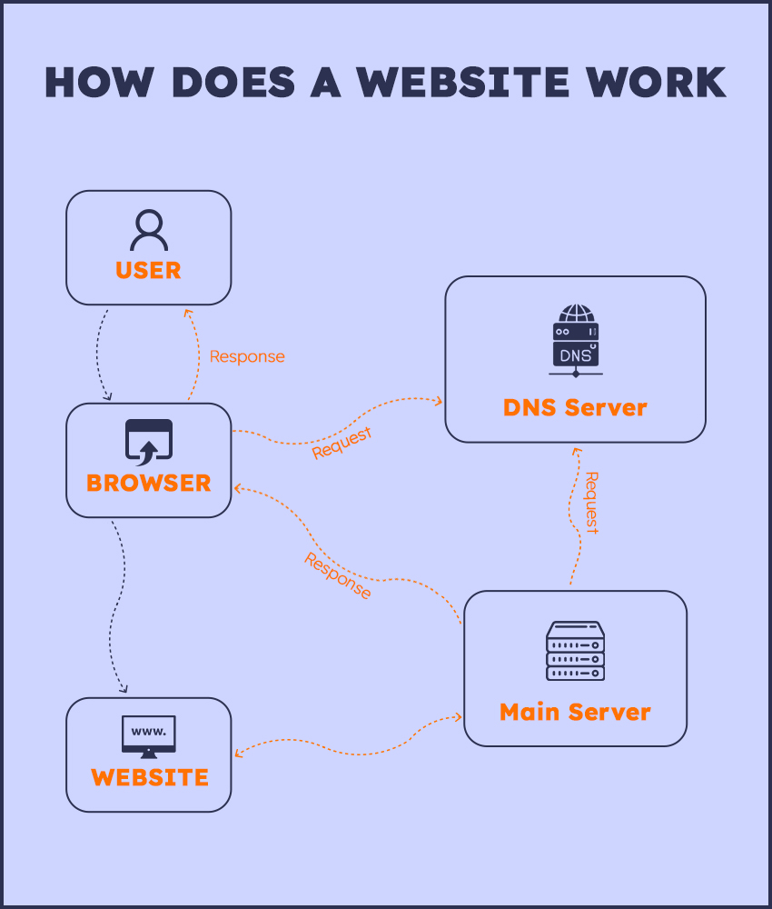
Working of a website:

Slide 5
Training project

Slide 6
Calmity: A blogging web application:
A comprehensive social website for providing Solaces (peaceful places) near you and around the world.
Offers a collection of blogs/destinations.
Promoting mental wellness, supporting tourism, and creating a sense of community among its users.

Slide 7
Objectives:
Blogs: Curated blogs that highlight peaceful destinations, nature getaways, and urban havens.A diverse range of content, including travel experiences, mindfulness tips.
User-contributed content: allowing members to share their serene experiences and travel tales.
Immersive: Visuals High-quality images that transport users to peaceful destinations.
User Profiles: User registration and login functionality.
Community and Social Features: A review section in blog for users to share their thoughts on the blog or place. Users can rate and review the blog, helping others find the best locations for serenity.
Geographical location: Represent exact location of the place mention in the blog in a map box.

Slide 8
Features:
User Authentication.
Review and Rating.
Create, View, Delete, Edit a Blog.
Immersive.
Geographical Location: geocoding and mapping.

Slide 9
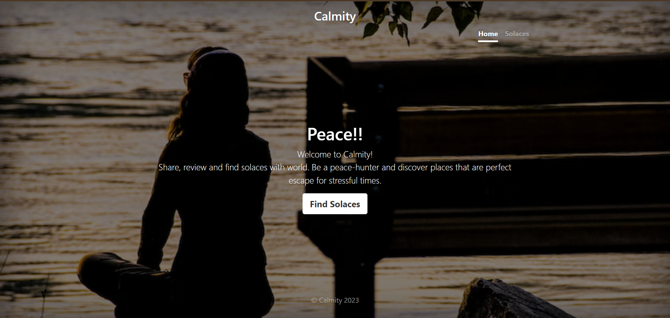
Snapshots:

Slide 10
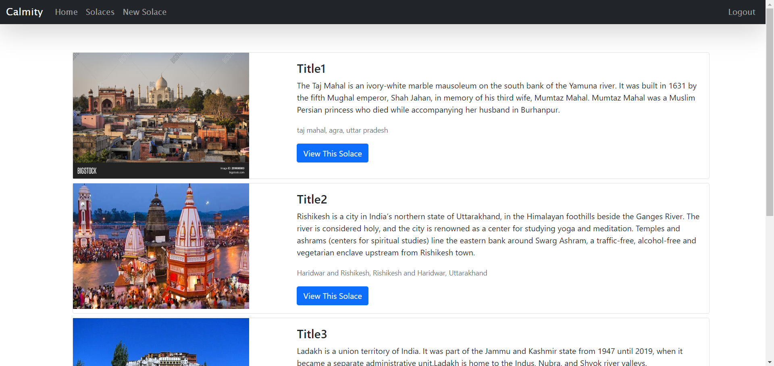

Slide 11
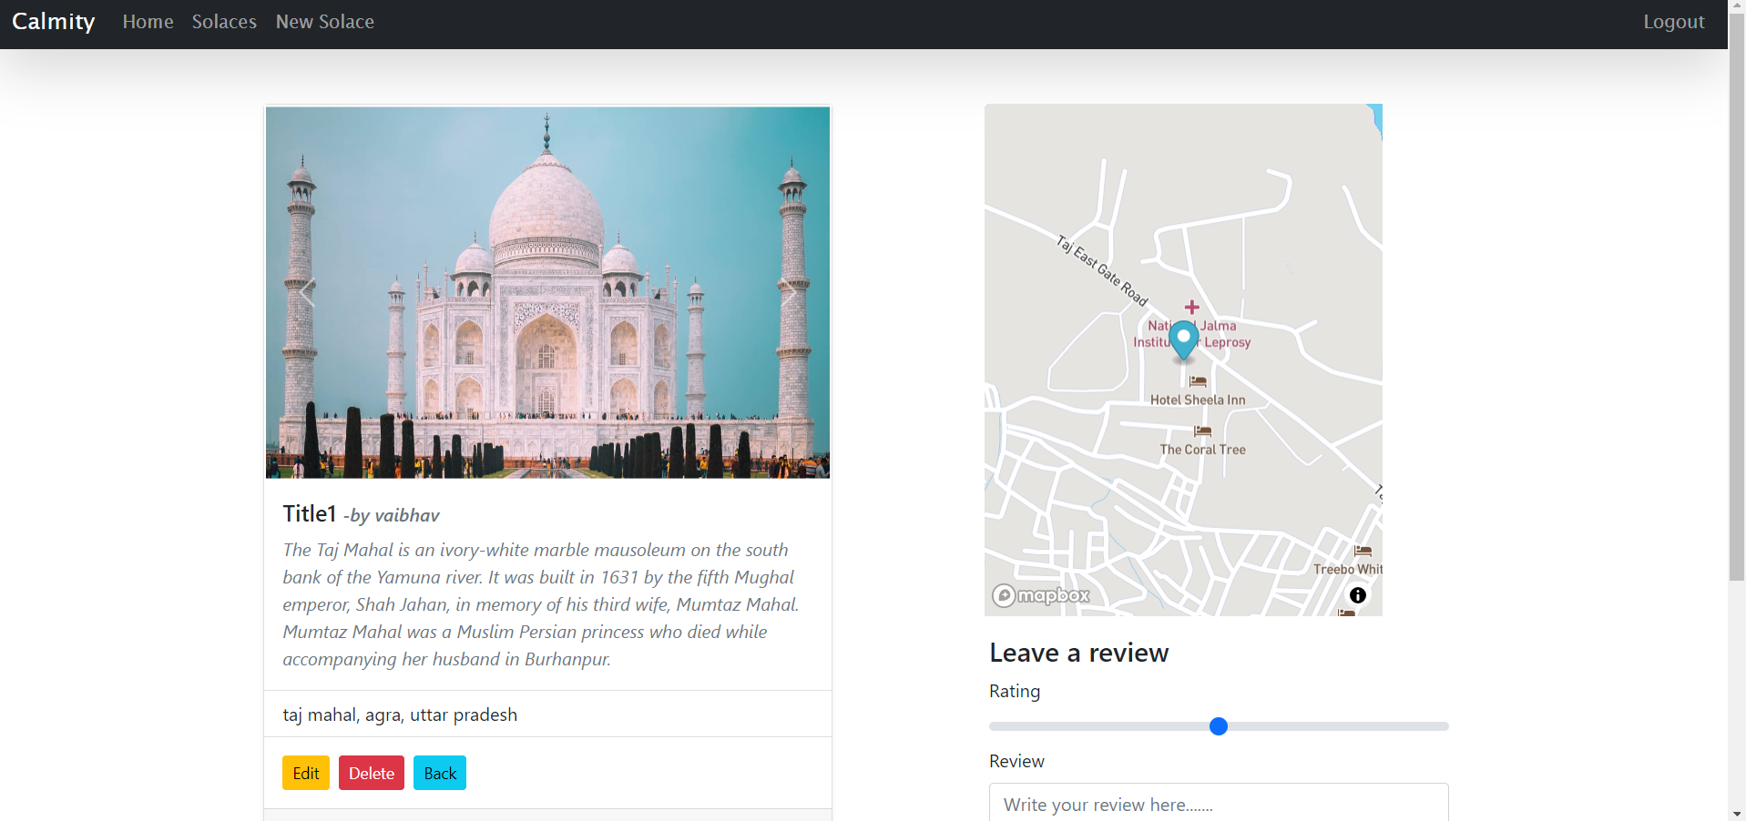

Slide 12
Thank you

